Slide 1
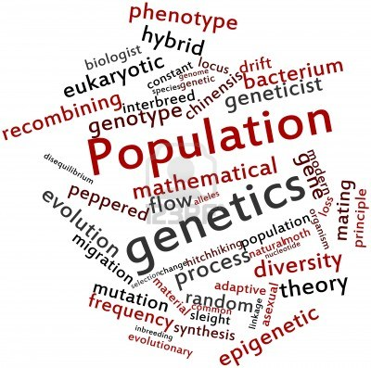
Population Genetics Interactive Case Discussion Pre-Class Exercise

Slide 2
Learning Objectives
By the end of this session, students should be able to…
Illustrate how historical human migration patterns have contributed to genetic variation observed in modern populations.
Differentiate between population subgroups defined by racial categories or geographic ancestry in terms of genetic variation.
Use the principles of population genetics (e.g. founder effect, Hardy-Weinberg equilibrium, selection pressure) to predict frequencies of alleles and genotypes in a given population.
Evaluate the significance of identifying the presence of disease alleles on the health care system and on individuals acquiring this information directly, in the absence of the guidance of a health care professional.
Assess the implications of evolving genetic testing technologies on yielding false negative results and the validity of the duty to recontact concept.

Slide 3
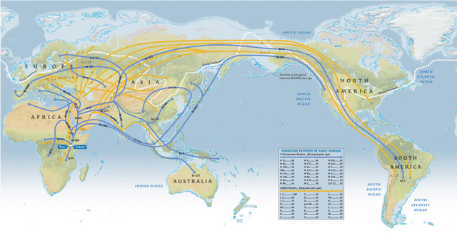
Population Genetics
Why is Population
Genetics Important?
Study of genetic variation in a population and how the frequency of a gene or allele in that population changes
Forms the basis of genetic counseling and the estimation of risk calculations
As of 1/2013, 22,000 known single gene traits defined in humans that lead to genetic diseases (OMIM)
The Genographic Project
Image retrieved from http://3cpg.cornell.edu/index.cfm/page/AncestryProject/AncestryEventsSpr2011.html on July 25, 2013. Permission received from National Geographic.
Notes:
Population Genetics is the study of genetic variation in a population and how the frequency of a gene in that population changes.
the population studied isn’t always the global population, as depicted in this global migration patterns cartoon but certain geographic ancestries or even a family
When you think about human variation, many people think about “race”. Traditional race concepts of Asian, European (or Caucasian) and African give an inaccurate picture of human variation. The genetic variation in European and Asian populations are subsets of the variation in the Western population.
Why is population genetics an important issue? Population genetics forms part of the basis of genetic counseling and the estimation of the risk calculations of having a disease or having children with a disease. Immediately in your future as a MS1, population genetics and Hardy-Weinberg equilibrium are popular USMLE test topics.

Slide 4
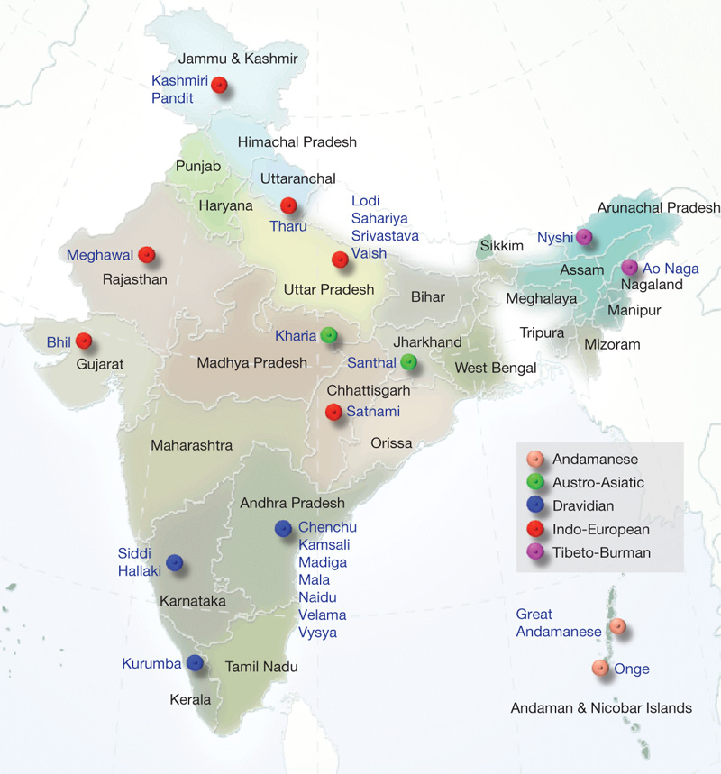
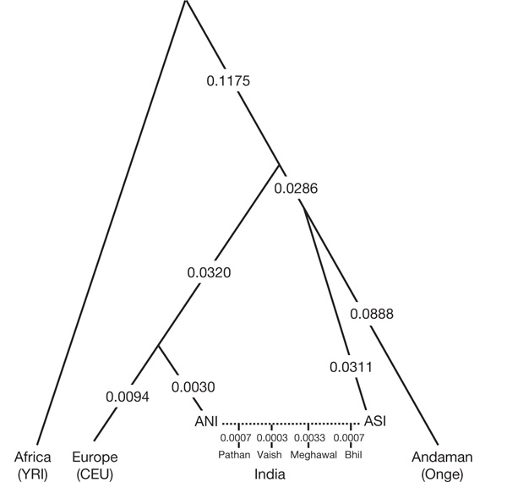
Geographic Ancestry
Genetic research has recently focused on the migration of ancestral human populations into different geographic areas
Using genome wide association studies, it is possible to determine the geographic ancestry of a person, the degree of ancestry from different regions, and migrational history
Due to group endogamy (marrying within a specific group), allele frequencies cluster around specific regions or ancestries.
Reich et al in Nature examined genomes of 125 individuals from 25 social, language, and geographic groups in India. They found:
Indian populations bear the genetic imprint of European, Asian, and even African genomes
Genetic diversity in India is 3x more than in Europe
Most Indian populations have a 39-71% mixture of variation from ancestral North India and ancestral South India
D Reich et al. Nature 461, 489-494 (2009) doi:10.1038/nature08365

Slide 5
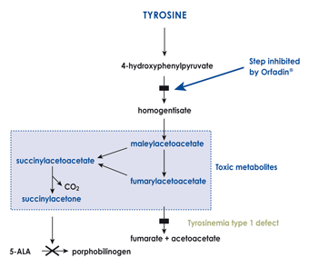
The Founder Effect
When a small subpopulation breaks off from a larger population, gene frequencies might change. If one of the “founders” of this new population is a carrier of a rare allele, then that allele will have a far higher frequency than it had in the larger group.
Lac St. Jean, Quebec and type I tyrosinemia
Martha’s Vineyard and hereditary deafness
Notes:
The founder effect is the loss of genetic variation that occurs when a new population is established by a very small number of individuals from a larger population. It was first described by Dr. Ernst May in 1942. Two examples of the founder effect close to home are the incidence of hereditary deafness on Martha’s Vineyard and the Lac St Jean region of Quebec and type I tyrosinemia.
The French-Canadian population in the Lac St. Jean region of Quebec is relatively isolated, and has a high frequency of type I tyrosinemia. Tyrosinemia is an autosomal recessive deficiency of fumarylacetoacetase, an enzyme involved in the degradative pathway of tyrosine. It leads to massive hepatic failure and renal tubular dysfunction.
Jonathan Lambert settled in Martha’s Vineyard in 1692, and suffered from hereditary deafness. 2 of his 7 children were deaf. Over time, people noticed that there were many more deaf inhabitants; in 1854 the national average of deaf people in the U.S. was 1 in 5729, in Chilmark, Martha’s Vineyard, it was 1 in 25. Interestingly, a sign language was developed on Martha’s Vineyard. For more information, please consult Everyone Here Spoke Sign Language, a book by Nora Groce.
Would you except the mutant alleles that contribute to type I tyrosinemia and hereditary deafness from a founder effect be from the same mutation?
Yes

Slide 6
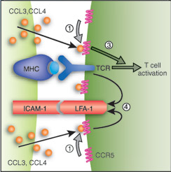
CCR5: a protein cytokine receptor
CCR5 (c-c chemokine receptor 5) is a protein receptor for cytokines (immune system attractant molecules) on the surface of many immune cells, including T cells, immature dendritic cells and mature macrophages.
A number of inflammatory CC-chemokines, including MIP-1 alpha, MIP-1 beta, RANTES, MCP-2, and HCC-1 act as CCR5 agonists, while MCP-3 is a natural antagonist of the receptor.
The CCR5 gene is located on the p arm at position 21 on chromosome 3.
Nature Immunology 6, 427 - 428 (2005)
Notes:
Let’s start off with an example: there is a gene encodes the protein cytokine receptor CCR5 (we’ll call it CCR5).
CCR5 is a protein that serves as a transmembrane cell surface receptor for certain cytokines, and is present on many immune cells, including CD4+ T lymphocytes, immature dendritic cells, and mature macrophages. CCR5 is one of the immune system receptors that mediates the process by which certain immune cells hone to specific organ and tissue targets. The receptor is depicted in pink on this cartoon. Cytokines like CCL3, 4, depicted in orange on the cartoon, as well as RANTES, MIP-1, MCP-2 and HCC-1 are CCR5 agonists.

Slide 7
CCR5 plays a major role in HIV pathogenesis
CCR5 and CD4 are binding proteins for the macrophage tropic lines of HIV 1 and HIV 2 viral particles gp41 and gp120 to mediate attachment to the T cell and subsequently infect.
Notes:
However, CCR5 also serves as a binding protein for the HIV virus as a way to enter the cell and it is depicted in this stylized cartoon as the yellow transmembrane protein. In this cartoon, gp120 and gp41 are the HIV attachment proteins, which bind with CD4 and the CCR5 costimulatory molecule to mediate attachment to the T cell and therefore, subsequent infection. CCR5 is considered the co-receptor for the macrophage tropic lines of HIV1 and 2, while CXCR4 is the co-receptor for the T cell trophic lines of HIV1 and 2.

Slide 8
ΔCCR5 and HIV resistance
ΔCCR5 is a 32 base pair deletion that leads to a frameshift mutation and nonfunctional protein.
Common in individuals of Northern European ancestry
Homozygote individuals do not express this receptor on the surface of their CD4 T cells and exhibit resistance to HIV infection.
Heterozygote individuals exhibit a delay in progression to AIDS
Notes:
There is an allele (ΔCCR5) that has a 32 base pair deletion that leads to a frameshift mutation and a nonfunctional protein. People with this mutation do not express this receptor on the surface of their CD4 T cells, and are therefore partially resistant to HIV infection (image source: cbsnews.com/8301-504763_162-20068780-10391704.html).

Slide 9
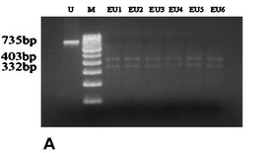
ΔCCR5 and HIV resistance
1 2 3 4 5 6 7 8
ΔCCR5 is detectable by gene PCR
no known clinical implications of homozygotes or heterozygotes other than HIV resistance
www.cdc.gov, accessed 10/8/12
Notes:
The ΔCCR5 mutation is detectable by PCR of the gene. The normal DNA is cut into 2 fragments by a restriction endonuclease, a 403 base pair fragment, and a 332 basepair fragment which are the two bands seen in lanes 3 to 8. The ΔCCR5 mutated DNA is not cleaved by the restriction endonuclease and seen in lane 1 as a 735 base pair fragment. Lane 2 is a molecular weight marker. There are no known clinical implications of homozygotes or heterozygotes individuals with this mutation, except for HIV resistance. Given the current state of the HIV epidemic, we would like to know the frequency of this allele!

Slide 10
Martinson et al. Nature Genetics
Genotype | Individuals | Genotype Frequency
CCR5/CCR5 | 647 | 0.821
CCR5/ΔCCR5 | 134 | 0.168
ΔCCR5/ΔCCR5 | 7 | 0.011
total | 788 | 1
We know the genotype frequencies from the study results
Calculation 1: CCR5 allele: (2x647) + (1x134) / 788x2 = 0.906
Calculation 2: ΔCCR5 allele: (2x7) + (1x134) / 788x2 = 0.094
Could you have obtained the allelic frequency of the ΔCCR5 allele without calculation 2?
Yes – just subtract the frequency of the CCR5 allele from 1 (as the frequency of two alleles must add up to 1).
Martinson, Chapman, and Rees et al performed PCR analysis of the CCR5 genes of 788 individuals in Europe in: Global distribution of the CCR5 gene 32 basepair deletion in Nature Genetics 16:100-103, 1997.
Notes:
We know the genotype frequencies from the study results (which must add up to 1). CCR5/CCR5 indicates no mutations and functional CCR5 proteins. CCR5/deltaCCR5 is a heterozygote for the mutation and delta CCR5/delta CCR5 is a homozygote deletion.
Let’s calculate the allele frequencies together.
- add more detail

Slide 11
Hardy-Weinberg Equilibrium
Dr. Hardy and Dr. Weinberg
developed the below formula
independently in 1908 (Dr.
Geoffrey Hardy was an English
mathematician, and Dr. Wilhelm
Weinberg, a German physician)
p + q = 1
p² + 2pq + q² = 1
Notes:
This method is too complicated: we can’t be genetically testing everyone (or can we?). Luckily, there is a Law that simplifies these calculations (assuming certain principles) and allows us to go backwards: to even calculate the proportion of a population with various genotypes once allele frequencies are known. It is called Hardy-Weinberg Equilibrium. Dr. Hardy and Dr. Weinberg developed the law independently in 1908. Dr. Geoffrey Hardy was an English mathematician, and Dr. Wilhelm Weinberg, a German physician. Here they are depicted together.
Hardy-Weinberg equilibrium is one of the cornerstone equations of population genetics, and a highly tested genetics topic on the USMLE. Hardy-Weinberg equilibrium states that there is a single relationship between allele frequencies and genotype frequencies in a population.

Slide 12
Some assumptions with Hardy-Weinberg equilibrium
The population is large and matings are random with regard to the genotype. Thus, genotype has no effect on mate selection. This allows the addition and multiplication rules to estimate genotype frequencies.
Allele frequencies are constant over time (as there is no appreciable rate of mutation, individuals with all genotypes are equally capable of mating and therefore passing along their genes, and no migration of individuals with allele frequencies different from the endogenous population)
Notes:
Before we get too deep into this…Hardy Weinberg Law has two main assumptions:
The population is large and matings are random
allele frequencies are constant over time (as there is no appreciable rate of mutation, individuals with all genotypes are equally capable of mating and therefore passing along their genes, and no migration of individuals with allele frequencies different from the endogenous population)
However, for every disease, we assume these are true. You will never be tested on non-Hardy-Weinberg equilibrium in this class or on the USMLEs.

Slide 13
Hardy Weinberg equilibrium states that allele frequencies and genotype frequencies are related.
Let’s say there are two alleles: A and a and three genotypes: AA, Aa, and aa. p is the frequency of allele A and q is the frequency of allele a.
The probability that a sperm cell carrying allele A fertilizing an egg cell carrying A is p x p (or p²) . The probability that a sperm cell carrying allele a fertilizing an egg cell carrying a is q x q (or q²).
What about the frequency of heterozygotes? Either a sperm cell carrying A can fertilize an egg carrying a or a sperm carrying a can fertilize an egg carrying A: (Aa x aA) = 2pq.
The Hardy-Weinberg law states that the frequency of the three genotypes AA, Aa, and aa is given by p² + 2pq + q² = 1 and that p + q = 1.
p² + 2pq + q² = 1
p = frequency of allele A
q = frequency of allele a
p² = genotype frequency of individual AA
q² = genotype frequency of individual aa
2pq = genotype frequency of individual Aa
You can use this framework to approach Hardy-Weinberg equilibrium problems
Notes:
Hardy Weinberg Equilibrium states that allele frequencies and genotype frequencies are related. Let’s say there are two alleles: A and a and three genotypes: AA, Aa, and aa. By convention, p is the frequency of allele A and q is the frequency of allele a. Under panmixia, the probability that a sperm cell carrying allele A with an egg cell carrying A is p x p (or p²) . The probability that a sperm cell carrying allele a with an egg cell carrying a is q x q (or q²). What about the frequency of heterozygotes? Either a sperm cell carrying A can unite with an egg carrying a or a sperm carrying a can unite with an egg carrying A: 2pq. The Hardy-Weinberg law states that the frequency of the three genotypes AA, Aa, and aa is given by p² + 2pq + q² = 1 and that p + q = 1.

Slide 14
Hardy-Weinberg equilibrium problem
We found that the frequency of CCR5 allele (A) was 0.906 and the frequency of the ΔCCR5 allele (a) is 0.094.
p² + 2pq + q² = 1
p = 0.906
q = 0.094
p² = genotype frequency of individual AA = 0.906 x 0.906 = 0.821
q² = genotype frequency of individual aa = 0.094 x 0.094 = 0.009
2pq = genotype frequency of individual Aa = 2(0.906x0.094) = 0.170
Thus, by the Hardy-Weinberg equation, the genotype frequencies are…
AA = 0.821
Aa = 0.170
aa = 0.009
these are the same frequencies measured in the Nature Genetics paper…
Notes:
But regardless, let’s prove it with the CCR5 example. We found that the frequency of CCR5 allele was 0.906 and the frequency of the ΔCCR5 allele is 0.094. So p = 0.906 and q = 0.094. So by the Hardy-Weinberg equation, AA = 0.906x0.906 = 0.821, Aa = 2pq = 2x(0.906x0.094) = 0.170, and aa = q² = 0.094x0.094 = 0.009. When these genotype frequencies, which were calculated by the Hardy-Weinberg law, are applied to 788 people, they are identical to that in the above table, found via PCR analysis.

Slide 15
Hardy-Weinberg and Autosomal Dominant Inheritance
Marfan’s syndrome is an autosomal dominant connective tissue disorder which is characterized by a mutation in the FBN1 gene, which encodes fibrillin-1. Fibrillin-1 is a glycoprotein component of the extracellular matrix. More than 30 different signs and symptoms are associated with Marfan’s syndrome, including dolichostenomelia (long, slender limbs), arachnodactyly (long digits), ectopia lentis, and aortic insufficiency. The incidence of Marfan’s syndrome in a particular population is 1 in 100000 individuals. What is the allelic frequency of mutated fibrillin-1 in this population?
In autosomal dominant disease, the components of Hardy-Weinberg equilibrium are a little different.
2pq = incidence of an autosomal dominant condition, includes only heterozygotes = 1 in 100000 or 0.00001
The allelic frequency of the diseased gene A (p) is usually very small, thus the allelic frequency of normal gene a (q) approximates 1.
q=1
If incidence = 2pq, then p = incidence / 2 x 1
p = 0.00001/2
p = 0.000005
p² = 2.5 x 10e-11 = 0
q² = genotype frequency of indv aa = 1 – 2pq – p² = 1 - 0.00001 – 0 = 0.99999
Notes:
The example of CCR5 and HIV resistance is an example of a phenotype inherited in an autosomal recessive fashion. Can you use Hardy-Weinberg equilibrium in diseases with other types of inheritance? Yes!

Slide 16
Hardy-Weinberg and X-linked Recessive Inheritance
Protanopia is one type of red-green color blindness inherited in a X-linked recessive fashion. In a certain population, the prevalence of protanopic males is 1 in 100. What is the frequency of protanopic females?
As males are hemizygous for the X chromosome, a male individual only has only copy of each trait, indicating that the frequency of affected males is equal to the allele frequency. Thus q = 0.01 and p = 0.99.
q = 0.01
p = 0.99
p² = 0.9801
q² = 0.0001
2pq = 0.0198
An affected female would be have two affected copies of the allele – thus the frequency would be 0.0001.

Slide 17
Selective Pressure
What if enough time progressed to allow selection for the CCR5 gene?
Under selection, individuals with advantages or “adaptive traits” such as resistance to the HIV infection are more successful than their peers reproductively and they contribute more genetic material to the succeeding generation than other individuals do.
for example, mitochondrial DNA (mtDNA) is not controlled by the nucleus: within-cell selection can favor mtDNA variants with a replication advantage.
Aanen and Maas, 2011
Notes:
picture: Aanen and Maas 2011

Slide 18
Would Hardy-Weinberg equilibrium truly apply going forward in this case of selection pressure?
NO
the allele frequencies are no longer constant

Slide 19
Contact Information
Katherine Larabee, MSIV
klarabee@bu.edu, pager 0742
Shoumita Dasgupta, PhD
dasgupta@bu.edu

